Slide 1


Presentation
On
AI-Based Multi-Stage Flood Forecasting and Early Warning System
Group No:12
Presented by
Swati Basliyal(2501321720060) Under the Supervision ​
Simran Anand(2501321720059) Ms. Arzoo Sorout
Ravina Ranjan(2501321720047)
Department of CSE-Cyber Security​
GNIOT Greater Noida, India

Slide 2
INTRODUCTION
The Threat: Floods are highly destructive, causing loss of life and severe infrastructure damage.
Traditional Limits: Conventional monitoring relies mostly on basic rainfall and predefined warning limits, missing how varying terrain and soil affect floods.
The AI Advantage: AI and Machine Learning learn from historical and current data to accurately assess flood risks.
Our Solution: A multi-stage system that predicts rainfall, estimates water levels, analyzes water behavior, and assesses area-specific flood risks rather than giving a simple "yes/no" prediction.

Slide 3
Problems Analysis & Existing Approach
1. Rainfall-Based Approaches
Use rainfall and weather observations to estimate flood conditions.
2. Water-Level / Flood Prediction
Predict future water levels or directly classify flood occurrence.
Limitation: A direct flood output may not explain how the flood develops.
3. Flood Inundation / Risk Models
Analyse flood depth, extent, flow, or affected areas.
Limitation: Often requires detailed hydrological, terrain, or spatial information.
Limitation: Rainfall alone does not fully represent the resulting water-level changes.
Problem Identified
Existing approaches often focus on individual stages of the flood process. This motivates a sequential approach that connects rainfall prediction with water-level forecasting and subsequent flood-risk analysis.

Slide 4
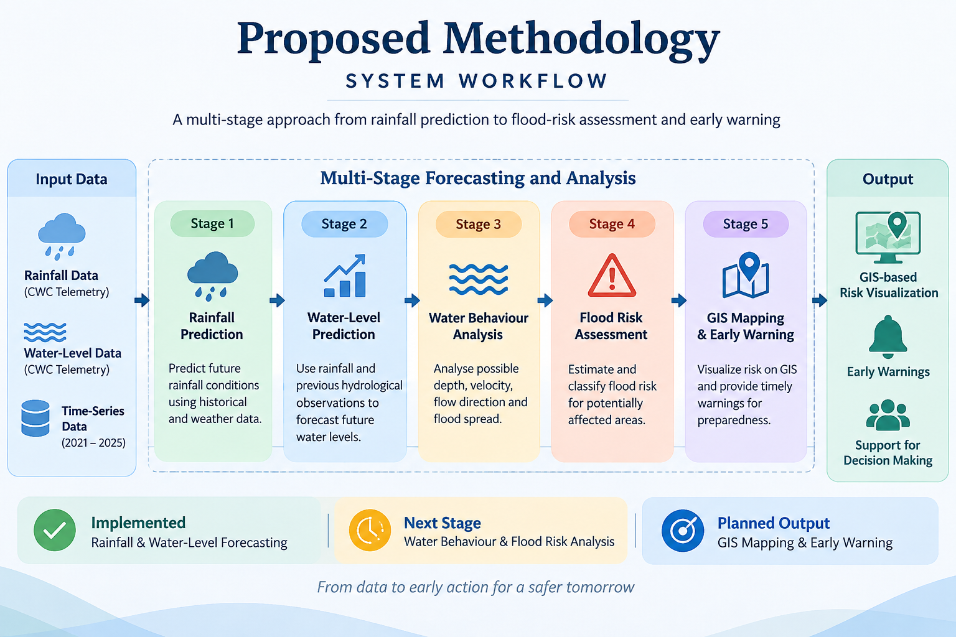

Slide 5
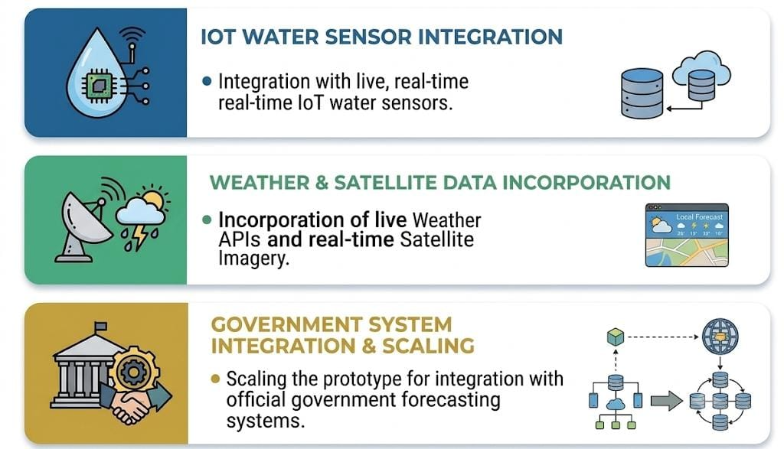
Future Work

Slide 6
Data Collection & Dataset
Rainfall Dataset
Source: Central Water Commission (CWC) – Telemetry
Location: Adityapur, Jharkhand
Data: Rainfall observations
Time Period: 2021–2025
Type: Time-series data
Water-Level Dataset
Source: Central Water Commission (CWC) – Telemetry
Location: Adityapur / Subarnarekha system
Data: River water-level observations
Time Period: 2021–2025
Type: Time-series data
These datasets provide the primary environmental and hydrological inputs for the forecasting stage.

Slide 7
Research & Reference
Asif, M., et al. (2025). “Review and Intercomparison of Machine Learning Applications for Short-term Flood Forecasting.”
Existing studies often focus on individual components such as rainfall, water level, or inundation.
Kuhaneswaran, B., et al. (2025). “Evolution of Data-Driven Flood Forecasting.”
The connection between successive stages of flood development is not always incorporated into one workflow.
McEachran, Z., et al. (2025). “Knowledge-Guided Machine Learning for Operational Flood Forecasting.”
Predicting flood occurrence alone may not explain how water conditions develop or which areas may be affected.
Environmental Modelling & Software studies (2025-2026) on Deep Learning alternatives and CNN frameworks.
Piadeh, F., et al. (2026). “AI-assisted framework for real-time urban flood risk forecasting.”
Changing rainfall and water-level conditions require predictions to be updated as new observations become available
Our Motivation
To develop a multi-stage framework that progressively uses rainfall information to forecast water levels and subsequently support water-behaviour analysis, flood-risk assessment and early warning.

Slide 8
Thankyou!

